Slide 1
Seniors -Constitutional Convention Forum “What You Don’t Know CAN Hurt You”
PSC CUNY Retirees
Presentation by Barry A. Kaufmann, President New York State Alliance for Retired Americans
PSC/CUNY Headquarters 61 Broadway, New York, NY October 2, 2017

Slide 2
What we’re up against in 2017
We are in a very different political climate than 1997
Multiple organized PRO-Constitutional Convention groups
NY People’s Convention (nypeoplesconvention.org)
Committee for a Constitutional Convention (concon19.org)
Reclaim NY (reclaimnewyork.org)
These groups have the potential to raise significant $$$
General sentiment among voters that “change” is needed

Slide 3
Who’s with us and against us at the current time?
Opposed to Convention
All of Labor
Council of Churches
State Republican Party
WFP
Conservative Party
The NRA
Immigration groups
NYS Association of Counties
Senate Majority Leader Flanagan, Speaker Heastie, Senate Minority Leader Stewart Cousins and Senate IDC Leader Klein
Planned Parenthood
Right to Life
For the Convention
Bill Samuels (NY Peoples Convention PAC)
NYS and NYC Bar Associations
ConCon19 – politically connected lawyers and professors
Long Island Association
NYS League of Women Voters
Assembly Minority Leader Kolb
Former Court of Appeals Chief Judge Jonathan Lippman
Former Lieutenant Governor Stan Lundine
Legal Weed 4 NY
Divide NYS Caucus

Slide 4
Odd year elections in NY
How many people will turn out to the polls?
History
Other races that are happening
Which areas of the state will they be from?
What type of voters show up in odd years?
Down-ballot drop-off

Slide 5
Public knowledge about the Constitutional Convention (Siena Poll)
 | May 18, 2017 | July 13, 2017 | Sept. 5, 2017/Union
A great deal | 4% | 5% | 8%/17%
Some | 9% | 9% | 11%/17%
Not very much | 19% | 18% | 21%/18%
Nothing at all | 67% | 67% | 58%/47%
Don’t Know | 1% | 1% | 1%/0%

Slide 6
Support / Oppose June ‘16 vs. Feb ‘17
 | May 18, 2017 | July 13, 2017 | Sept. 5, 2017
Support | 62% | 47% -15% | 45% -2%
Oppose | 22% | 34% +12% | 33% -1%
Don’t Know | 17% | 19% +2% | 22% + 3%

Slide 7
Among Union Households
 | May 18, 2017 | July 13, 2017 | Sept. 5, 2017
Support | 60% | 43% -17% | 40% -3%
Oppose | 28% | 38% +10% | 43% +5%
Don’t Know | 12% | 19% + 7% | 17% -2%

Slide 8
Proposed Amendment allowing a court to revoke pensions of guilty public servants July 13, 2017
Yes | 75%
No | 18%
Don’t Know/No opinion | 7%

Slide 9
History of Convention Votes
1914: Vote to hold Constitutional Convention passes - 50.2% to 49.7% (0.5%)
1915 Convention: Voters reject 33 constitutional language changes and 5 amendments
1936: Vote to hold Constitutional Convention vote passes - 54.2% - 45.7% (8.5%)
1938 Convention: Voters Accept 6 amendments and reject 3 amendments
1957: Vote to hold a Constitutional Convention fails – 47.5% to 52.4% (4.9%)
1967: Vote to hold Constitutional Convention vote passes – 53.3% to 46.6% (6.7%) 1967 Convention: Voters reject major rewrite of the NYS Constitution
1977: Vote to hold a Constitutional Convention fails – 40.3% to 59.6% (19.3%)
1997: Vote to hold a Constitutional Convention fails – 37.0% to 62.9% (25.9%

Slide 10
The Amendment Process
The state constitution can be amended in two ways.
By passage of individual bills for specific purposes, by two separately elected state Legislatures (Article 19, § 1).
Bills then appear on the general election ballot for passage by the voters.
This process has been used nearly 200 times since the last major constitutional redraft in 1894.
This process was undertaken in 2013 for several changes, including:
Casino Gaming in New York State – PASSED
Sale of specific lands within the constitutionally protected Adirondack Park – PASSED
Increasing the mandatory retirement age for state judges - FAILED

Slide 11
This process was again used in the fall of 2014 for two more proposed changes:
Creation of an Independent Commission on Redistricting – PASSED
Allows the Senate and Assembly to go paperless – PASSED
Constitutional requirement – paper bills must sit on legislators desk for three days;
Would allow bill being “in print” to count toward the three days; and
Will save $325,000 a year in paper and printing costs.

Slide 12
2nd Way to Amend
Holding a constitutional convention (Article 19, § 2)
Question goes before the voters every 20 years
Allows for much wider modifications of the constitution; including a full rewrite
The last convention to produce ANY Amendments to the NYS Constitution was in 1937
Since 1914 only 6 Amendments have passed all in 1937

Slide 13
"Shall there be a convention to revise the constitution and amend the same?" Article XIX, Section 2

Slide 14
2017 Ballot Position of Propositions/On the Back of the Ballot
Proposition 1 – Constitutional Convention
Proposition 2 – Ability of Judges to Revoke State Pensions
Proposition 3 – Establish a 250 acre land bank

Slide 15
Timeline
2017 | 2018 | 2019 | 2020+
The question is submitted to voters | Delegates elected to the convention at the General Election | Delegates convene on the First Thursday of April | Approved Amendments take effect in January of the following year
 |  | Amendments submitted to the voters. (2019 or later)

Slide 16
Delegate Selection
Delegate Allocation | Selection
3 Delegates to the Convention elected by the voters in each of the 63 Senate Districts (189) 15 At-Large Delegates elected by the voters statewide 204 Total Delegates. | The general provisions of the election law would apply, unless the legislature amends and proscribes another methodology. Party Nomination for Senate-Wide delegates – 5% of enrolled party members within the Senate district and not more than 1,000 signatures. Independent – 5% in the Senate district and not more than 3,000 signatures

Slide 17
Convention Operations
Compensation
Same rate as a Member of the Assembly
Proceedings
Constitution contains few directives about the running of the Convention.
Electing officers, adoption of rules, and organizational decisions are left to those elected to serve as delegates.
The Convention determines when to adjourn and whether amendments will be submitted to the voters in parts or as one package.
However, submission cannot occur sooner than six weeks

Slide 18
Problems with the Constitutional Convention
Cost – 1967 Estimate - $50 million $ 100’s of Millions in cost this year
Those likely to be elected will be legislators, judges
No way to limit scope
People view Constitutions with reverence
Major parties will control the process
Constitutional amendments already possible through legislative process
Legislators collect their legislative salary PLUS Delegate Salary (Same as Legislative salary)

Slide 19
Same old, same old Is this REALLY a People’s Convention???
1967 Convention Delegate Breakdown:
67% of the delegates were lawyers.
25% were a legislator at one time.
15% served in the judicial system at one time.
50% served in a political party office at one time during their career.
Speaker of the Assembly served as President of the Convention.

Slide 20
What is driving Con –Con this time
Sheldon Silver, Convicted of crimes related to his position.
Dean Skelos, Convicted of crimes related to his position.
Over the past 13 years 29 state legislators or former legislators convicted of felonies, misdemeanors or violations.
Twenty-one have been sentenced to prison or house arrest.
The drive to diminish pensions

Slide 21
The Facts about ethics reform
Pension forfeiture related to work CAN be accomplished through normal legislative process.
Pension forfeiture related to work WAS accomplished for those entering the system after November 2011.
A law to apply the pension forfeiture statute to all public officers convicted of a felony related to job duties was passed several months ago for the second time. IT WILL APPEAR ON THE NOVEMBER BALLOT ALONG WITH THE CALL FOR A CONSTITUTIONAL CONVENTION

Slide 22
Reasons Given by Supporters of a Constitutional Convention
Voting reforms, bringing New York’s elections into the 21st century
Rooting out corruption, including reducing the influence of money in our political system and
Instituting an effective ethics enforcement agency
Fair legislative redistricting, completely removed from sitting legislators
Streamlining and modernizing our court system, making it more effective
Reinforcing and strengthening our bill of rights, guaranteeing our personal freedoms and meeting our basic human needs.

Slide 23
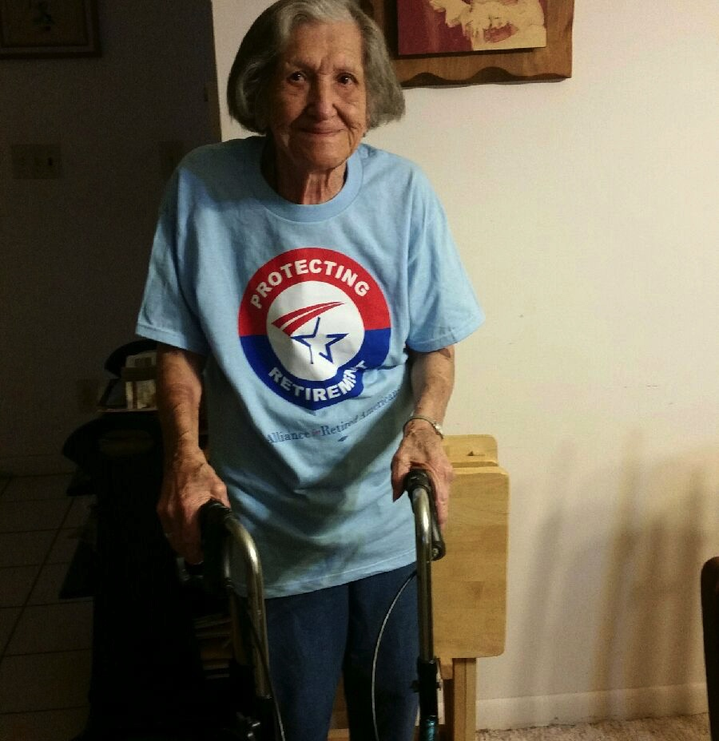
WHAT IS AT STAKE FOR PRESENT AND FUTURE SENIORS????

Slide 24
ARTICLE II SECTION 2 Absentee Voting
Seniors use the absentee ballot system more than any other demographic
Altering or changing the absentee ballot system to be more restrictive would potentially suppress the vote of seniors that are not ambulatory.
Reducing the number of seniors voting would diminish the impact of senior issues in both state and national politics.

Slide 25
Article V Section 7 Pension Maintenance
Some think pensions too generous and 401k’s should replace them.
401k’s never designed for retirement
Defined benefit pensions significantly contribute to the New York and United States economy.
Defined benefit pensions AVERAGE $32,000 in New York.
Seniors with 401k’s ONLY are less prepared for retirement and more likely to need some form of public assistance

Slide 26
Economic Benefits to Defined Benefit Pensions in NYS According to the National Institute for Retirement Security
Defined benefit pensions contribute to the creation of 215,867 jobs in NYS
Defined benefit pensions increase economic output(direct, indirect and induced) by $35.28 billion per year in NYS
Defined benefit pensions result in the payment of over $ 4 billion per year in federal taxes and $4.13 billion in state taxes from New Yorkers collecting these pensions

Slide 27
Article 1 Section 11 Equal Protection
This article protects against age discrimination.
This is important in housing, jobs etc.
It is especially important as by 2020 31% of those between 65 and 75 will be in the workforce. Many in minimum wage jobs.

Slide 28
Article I Section 17
Provides Minimum Wage Protection
Guarantees an 8 hour work day
Provides a protection against child labor
Would affect how overtime is treated.

Slide 29
Article XVII Social Welfare/Public Relief
AKA – Providing for the indigent.
In today’s profit driven healthcare industry, it wouldn’t take long for profiteers to take advantage of loose or repealed regulations/laws protecting the indigent and aged

Slide 30
Article XVIII Housing
Guarantees oversight and protection of nursing homes in NY. Do we really want to eliminate that protection?

Slide 31
Article XIV Conservation
Adirondack Forest “forever wild”
Clean water and air could be back on the table.

Slide 32
Various Sections Taxes Senior provisions that allow them to remain in New York after retirement
Star Exemption on real property taxes taken away or slashed drastically
Tax exemption for Social Security income could be lost. (13 states do NOT offer this exemption)
Tax exemption for City, State and Federal Pensions (41 States DO tax public pensions)
$20,000 exemption from taxes for 401k, IRA or any other pension. (32 States either have no exclusion or exclude but count Social Security in that exclusion)

Slide 33
NYSARA Future Actions to Address our Issues
Created a Con-Con toolkit tab on the NYSARA website with sample letters to the editor, Op Ed’s, sample social media posts and other information and surveys on the Constitutional Convention. Up and running
Met with NYS Legislative leaders (Kolb, Klein, Flanagan and Stewart Cousins, Heastie and Hannon) on State issues.
Have each NYSARA chapter run a forum on the possible negative outcomes for Seniors of the constitutional convention Already held one on Long Island and NYC, upcoming ones scheduled WNY and CNY.

Slide 34
NYSARA Future Actions to Address our Issues # 2
Continue to travel and speak at events designed to educate, to insure that many eyes are watching what elected’s do and that a constitutional convention is rejected.
MORE POSSIBILITIES AS WE GO ALONG AND ASSESS THE SITUATION ON THE GROUND

Slide 35
On November 7th

Slide 36
What Can Activists Do?
Get more retirees to vote their true interests, not the rhetoric.
Write letters to the Editor about our issues
Continue to be Activists and encourage others.
Consider running for office ie: Christine Pellegrino/NYS Assembly and Rick Gallant NY CD 24 (Reed)
Educate Yourself on the Truth about Social Security, Medicare, Medicaid, the Constitutional Convention in NYS, Safe Patient Staffing, New York Health Act and Defined Benefit Pensions vs. Defined Contribution pensions
Explode myths and rhetoric of others including elected officials.
Become active in one of the Regional Chapters of the New York State Alliance for Retired Americans (NYSARA) and continue activism in your NYSUT Retiree council.

Slide 37
Stay informed
Sign up for Monday Alert
on the bright colored sheets

Slide 38
Find NYSARA on the web www.newyorkstateara.org
Like us on Facebook
www.facebook.com/newyorkstateara
or if you are already on Facebook
^{Find us at}
New York State Alliance for Retired Americans
^{Find us on Twitter @nysara17}
^{Barry A. Kaufmann, President}
^{president@newyorkstateara.org}

